Slide 1
Live 360! Events Review
Mini HTML 5 Overview
Follow along at:
http://bit.ly/15u1FQ8 or http://html5demo1.azurewebsites.net/
Presented by Darek Tomyn
Darek.Tomyn@solvera.ca
Notes:
You may access all of the material for the event by clicking on the title
(which will take you to http://www.redmondevents.com/virtual/login.aspx?ReturnUrl=%2fvirtual%2fvslive%2f2012%2flive360%2fDefault.aspx)
From there, you can authenticate using the following credentials:
Username: LIVE!360
Password: Orlando4in1

Slide 2
Quick Summary
Historically, was a Visual Studio Live annual event in Orlando
1st time “combined 4 events into 1”:
Visual Studio
SharePoint
SQL Server
Cloud & Virtualization
Often there were 16 sessions happening at once!
First and last days were “workshops”
Microsoft technologies but not hosted by Microsoft

Slide 3
What I learnt
Big Data
Azure
Other…
HTML5
Websites
History
<audio>
<video>
SharePoint
offline
CSS3
storage
<canvas>
svg
Modernizr
Tags: Simplification and Semantic
MVC 4
<form> enhancements
OAuth
SignalR
Browser
Support
SQL Server 2012 New Features
jQuery mobile
VS ALM
Nuget
Git
Bitly

Slide 4
What I learnt
Big Data
Azure
Other…
HTML5
Websites
History
<audio>
<video>
SharePoint
offline
CSS3
storage
<canvas>
svg
Modernizr
Tags: Simplification and Semantic
MVC 4
<form> enhancements
OAuth
SignalR
Browser
Support
SQL Server 2012 New Features
jQuery mobile
VS ALM
Nuget
Git
Bitly

Slide 5
HTML5 History
Wee bit of history¹:
CERN and IETF: HTML (1991), HTML2 (1994)
W3C: HTML3 (1995), HTML3.2 & 4 (1997)
W3C decided to stop evolving “HTML” (1998)
W3C: XHTML1 (2000), XHTML 1.1 (2001)
W3C wanted XHTML 2… but was very strict standard
Browser group formed WHATWG² and created HTML5
Group contained: Apple, Mozilla, Opera
W3C’s XHTML 2 ultimately died on July 2, 2009
WHATWG gave W3C permission to publish HTML5… so really there are 2 specifications out there
Notes:
¹For an interesting “history” read, check out http://html5forwebdesigners.com/history/index.html or WHATWG’s http://www.whatwg.org/specs/web-apps/current-work/multipage/introduction.html#history-1
²WHATWG is an acronym for the “Web Hypertext Application Technology Working Group” http://www.whatwg.org/

Slide 6


HTML5 History
Apple’s affect:
“The world is moving to HTML5” – Steve Jobs
iDevices have no support for Flash
Logo
Marketing material

Slide 7
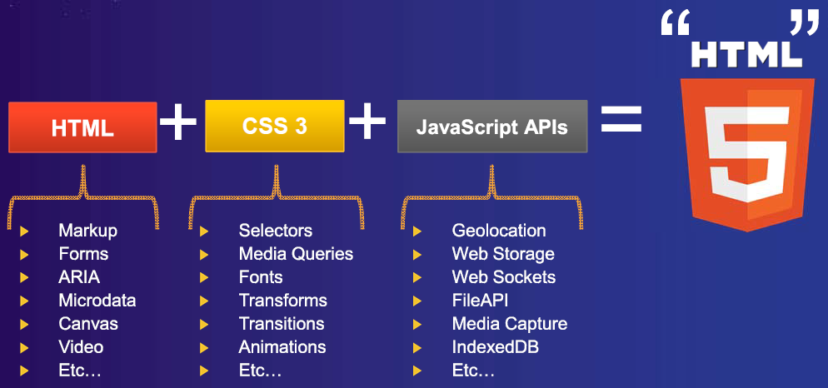
HTML5 – What is it?
What is it? HTML + CSS3 + JavaScript APIs

Slide 8
What I learnt
Big Data
Azure
Other…
HTML5
Websites
ü
<audio>
<video>
History
SharePoint
offline
CSS3
storage
<canvas>
svg
Modernizr
Tags: Simplification and Semantic
MVC 4
<form> enhancements
OAuth
SignalR
Browser
Support
SQL Server 2012 New Features
jQuery mobile
VS ALM
Nuget
Git
Bitly

Slide 9
HTML5 – Simplification
<!DOCTYPE html PUBLIC "-//W3C//DTD XHTML 1.0 Strict//EN" "http://www.w3.org/TR/xhtml1/DTD/xhtml1-strict.dtd">
<!DOCTYPE html>
<html lang="en" xmlns="http://www.w3.org/1999/xhtml" xml:lang="en">
<html lang="en">
<meta http-equiv="Content-Type" content="text/html; charset=utf-8" />
<meta charset="utf-8">
Some others:
The type attribute is no longer required on <style> and <script> tags
Elements that are by nature self-closing no longer need a “/”
img
br

Slide 10
HTML5 – New Tags
<div id=“header”>
<header>
<div id=“nav”>
<nav>
<div id=“aside”>
<aside>
<div id=“article”>
<div id=“section”>
<article>
<section>
<footer>
<div id=“footer”>

Slide 11
What I learnt
Big Data
Azure
Other…
HTML5
Websites
ü
<audio>
<video>
History
SharePoint
offline
CSS3
storage
<canvas>
svg
Modernizr
Tags: Simplification and Semantic
MVC 4
<form> enhancements
ü
OAuth
SignalR
Browser
Support
SQL Server 2012 New Features
jQuery mobile
VS ALM
Nuget
Git
Bitly

Slide 12
HTML5 - Browser Support
Spec moves through:
1st Published Working Draft
Working Draft
Last Call
Candidate Recommendation
Recommendation
IE goal is CR and up … as a result, they “score” much lower… but are getting better
One easy option is Google Chrome Frame for <=8¹
Notes:
¹ Chrome browser engine in IE 6/7/8/9
chrome=1 - Always active
chrome=IE7 - Active for IE major version 7 or lower
chrome=IE8 - Active for IE major version 8 or lower

Slide 13
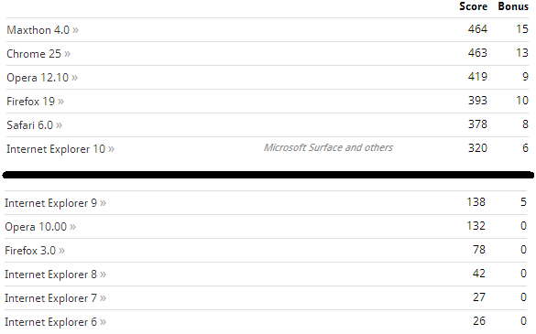
HTML 5 – Browser Support (cont’d)
Html5test.com, CanIuse.com, and lots of others
Adoption strategies: lowest common denominator, polyfill¹ enriched
DEMO 1 – 2 from
http://html5demo1.azurewebsites.net/Index.html
Notes:
¹ Recommended resources regarding polyfills: http://remysharp.com/2010/10/08/what-is-a-polyfill/ or https://github.com/Modernizr/Modernizr/wiki/HTML5-Cross-browser-Polyfills

Slide 14
What I learnt
Big Data
Azure
Other…
HTML5
Websites
ü
<audio>
<video>
History
ü
SharePoint
offline
CSS3
storage
<canvas>
svg
Modernizr
Tags: Simplification and Semantic
MVC 4
<form> enhancements
ü
OAuth
SignalR
Browser
Support
Mobile general
ü
SQL Server 2012 New Features
jQuery mobile
VS ALM
Nuget
Git
Bitly

Slide 15
HTML5 Form Enhancements
<input type=
Email, url, search, number, date, time, color, etc
New attributes
Placeholder, autofocus, required, pattern, contenteditable
Remember sites mentioned previously: Html5test.com, canIuse.com
Also… Don’t “sniff” for browsers… test for features using something like Modernizr
Demo 3 from
http://html5demo1.azurewebsites.net/Index.html

Slide 16
What I learnt
Big Data
Azure
Other…
HTML5
Websites
ü
<audio>
<video>
History
ü
SharePoint
offline
CSS3
storage
ü
<canvas>
svg
Modernizr
Tags: Simplification and Semantic
MVC 4
<form> enhancements
ü
ü
OAuth
SignalR
Browser
Support
Mobile general
ü
SQL Server 2012 New Features
jQuery mobile
VS ALM
Nuget
Git
Bitly

Slide 17
HTML5 MultiMedia Enhancements
New “audio” and “video” tags
Demo 4 from
http://html5demo1.azurewebsites.net/Index.html

Slide 18
What I learnt
Big Data
Azure
Other…
HTML5
Websites
ü
<audio>
ü
History
<video>
ü
SharePoint
offline
CSS3
storage
ü
<canvas>
svg
Modernizr
Tags: Simplification and Semantic
MVC 4
<form> enhancements
ü
ü
OAuth
SignalR
Browser
Support
Mobile general
ü
SQL Server 2012 New Features
jQuery mobile
VS ALM
Nuget
Git
Bitly

Slide 19
Windows Azure
What is it?
From Wikipedia: “is a Microsoft cloud computing platform for building, deploying and managing applications and services through a global network of Microsoft-managed datacenters”
Some interesting aspects of this are:
Easy on demand provisioning
Easy scaling of resources… for example “tonight I need 10,000 nodes for an hour until batch is done”
Demo 5
https://manage.windowsazure.com

Slide 20
What I learnt
Big Data
Azure
Other…
HTML5
Websites
ü
ü
ü
<audio>
ü
History
<video>
ü
SharePoint
offline
CSS3
storage
ü
<canvas>
svg
Modernizr
Tags: Simplification and Semantic
MVC 4
<form> enhancements
ü
ü
OAuth
SignalR
Browser
Support
Mobile general
ü
SQL Server 2012 New Features
jQuery mobile
VS ALM
Nuget
Git
Bitly

Slide 21
Trends - SignalR
Makes real-time HTTP so easy it seems like “magic” ¹
An open source series of libraries that provide an abstraction around persistent HTTP connections²
Demo 6
HitCounter
Notes:
¹ “Any sufficiently advanced technology is indistinguishable from magic” – Arthur C. Clarke
² http://www.asp.net/signalr/

Slide 22
What I learnt
Big Data
Azure
Other…
HTML5
Websites
ü
ü
ü
<audio>
ü
History
<video>
ü
SharePoint
offline
CSS3
storage
ü
<canvas>
svg
Modernizr
Tags: Simplification and Semantic
MVC 4
<form> enhancements
ü
ü
OAuth
SignalR
ü
Browser
Support
Mobile general
ü
SQL Server 2012 New Features
jQuery mobile
VS ALM
Nuget
Git
Bitly

Slide 23
Other observations
Nuget
Visual Studio add-in to import in external resources easily
Git
Cvs -> svn -> git
Bit.ly
Less and less people using tinyurl.com
“Big data”
still in infancy (IMO)

